Slide 1

MENTORSHIP PROGRAM
DAILY.DEV
NEWS AGGREGATOR
CHALLENGE
Name: Thanh Nguyen

Slide 2
OVERVIEW
1. USE CASE
2. UI/UX
3. DATABASE

Slide 3
1.USE CASE

Slide 4
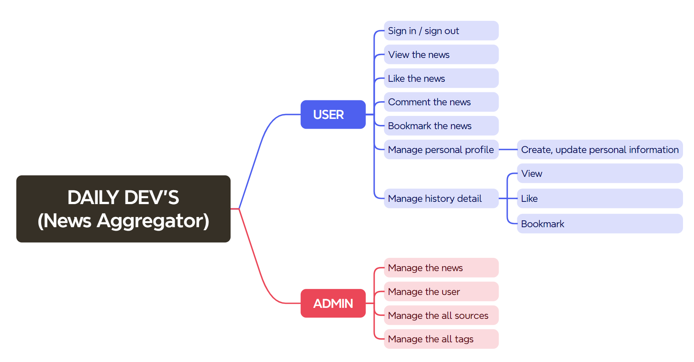

Slide 5
2.UI/UX

Slide 6
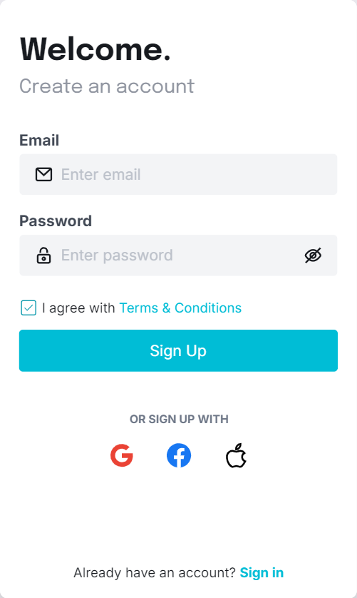
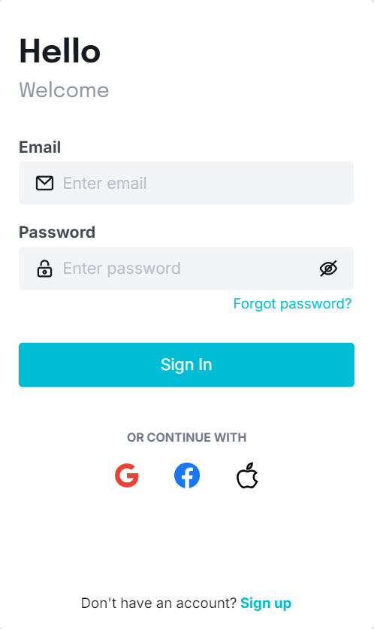
Sign In
/
Sign Out

Slide 7
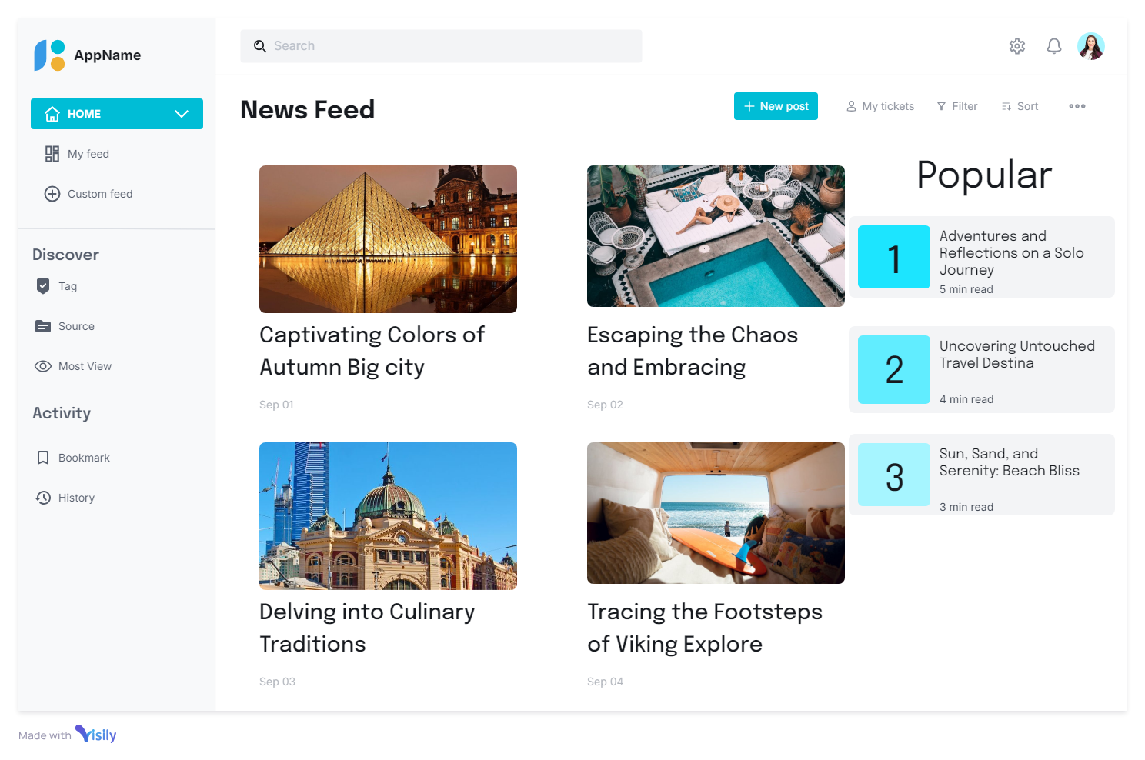
News Feed

Slide 8
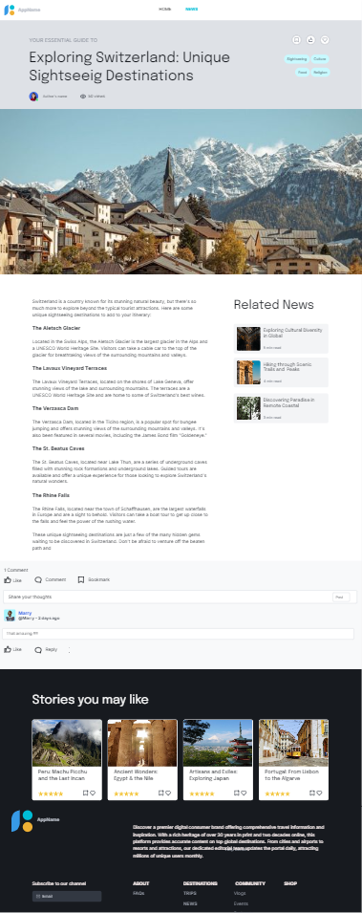
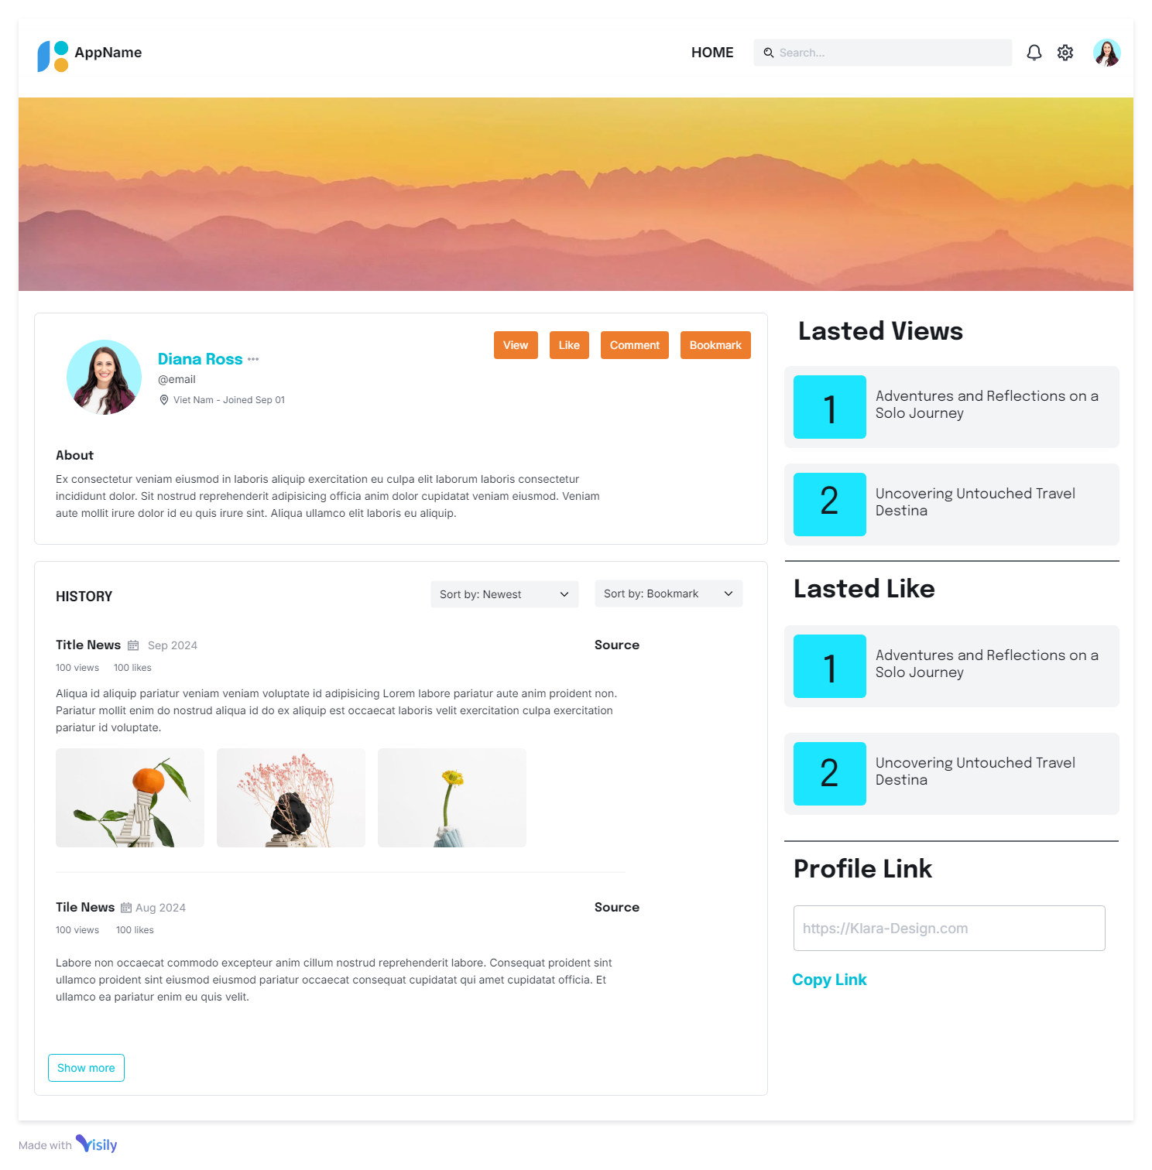
News
Profile

Slide 9
3.DATABASE

Slide 10
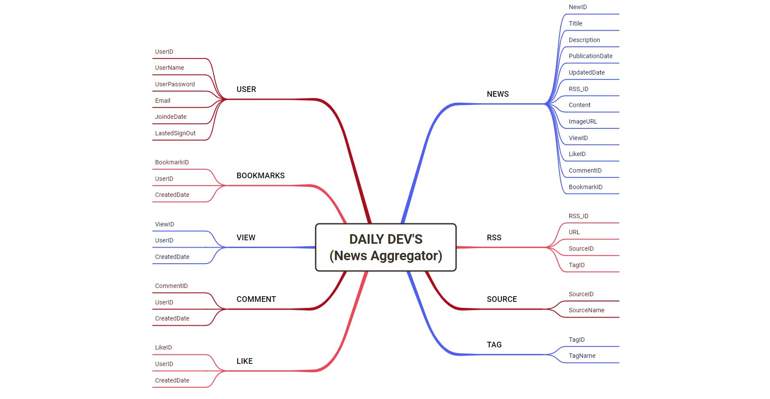
MINDMAP

Slide 11
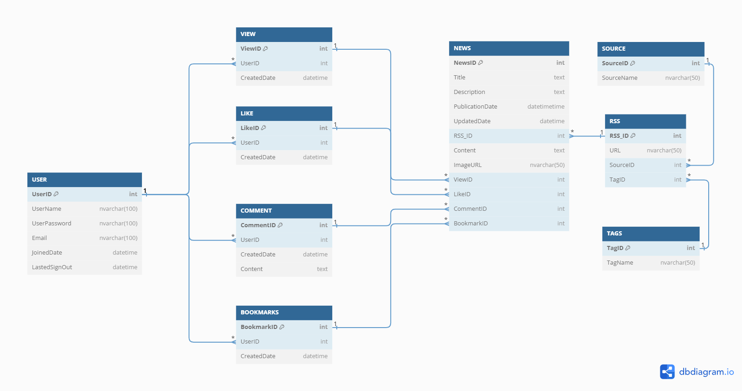
DIAGRAM

Slide 12
Thank You!

